Slide 1
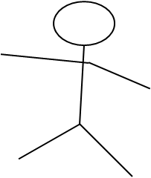


FB
TB
transformation
transformation
Test
toma toma!
toma toma!
DV
P has seen, that ID2 is in left box. Then he states: I want toma. He tries to open right box, but has no key. If child assumes, that P knows that ID1 = ID2 it should assume, that P searches sth. different and help him open the second box as in TB. If child assumes, that P does not know that ID1 = ID2 it should open Box 1 and show transformation

